Slide 1

RED HAT LINUX ADMINISTRATION l
RHEL9

Slide 2



Red Hat Enterprise Linux 9 RH124
Objective
RHCSA Exam
Red Hat System Administration I
Develop the foundation skills required for RHCSA
You need to study two books: SA1 (RH124) and SA2 (RH134)
This course will help you gain a better understanding of the book SA1

Slide 3


Red Hat Enterprise Linux 9
o1.
Who will be the target audience for this course module?
o2.
What are the prerequisites for this?
o3.
About the Instructor !
o4.
After successfully completing the Course !
o5.
Thank You !!!

Slide 4
Red Hat Enterprise Linux 9 RH124
RHEL 9 Standard Installation
RHN Account, Red Hat Login ID.
Download RHEL 9.2 ISO.
Installation of RHEL 9.2, step by step using Oracle Virtual Box
RHEL 9.2 dependencies for VirtualBox Guest Additions.
Access the Linux System locally and remotely.
Troubleshooting.

Slide 5
RED HAT LINUX ADMINISTRATION l
Create a Red hat Login
1. Open a Web Browser.
2. Go to the Red Hat Website.
3. Access the Registration Page.
4. Fill in Your Information.
5. Accept Terms and Conditions.
6. Complete the CAPTCHA (if required).
7. Verify Your Email (if required).
8. Log In.
9. Explore Red Hat Resources:
After logging in, you can access various resources, downloads, support, and documentation related to Red Hat products and services.

Slide 6
Red Hat Enterprise Linux 9 RH124
Access the Command Line
Introduction to the Bash Shell
Log in to a Local System
Log in to a Remote System
Log out from a Remote System

Slide 7
Red Hat Enterprise Linux 9 RH124
Access the Command Line with the Desktop
Introduction to the GNOME Desktop Environment
Parts of the GNOME Shell
Understand Workspaces
Start a Terminal
Lock the Screen and Log Out
Power off or Reboot the System

Slide 8
Red Hat Enterprise Linux 9 RH124
Execute Commands with the Bash Shell
Basic Command Syntax
Write Simple Commands
Tab Completion
Write Long Command on Multiple Lines

Slide 9
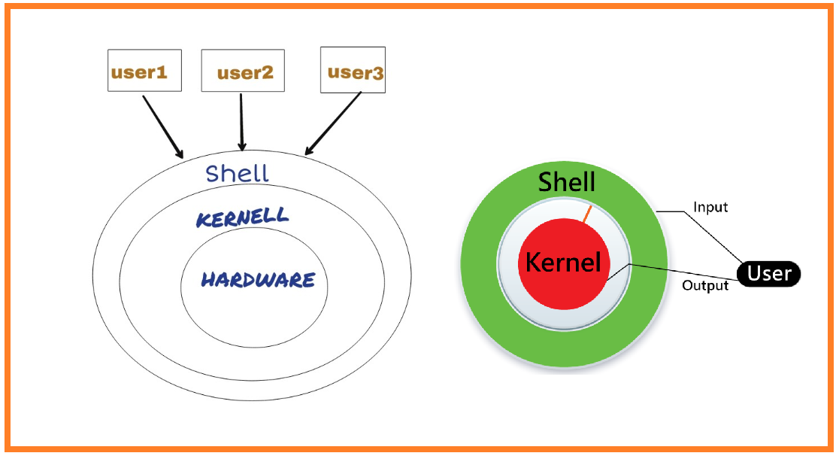
Red Hat Enterprise Linux 9 RH124

Slide 10
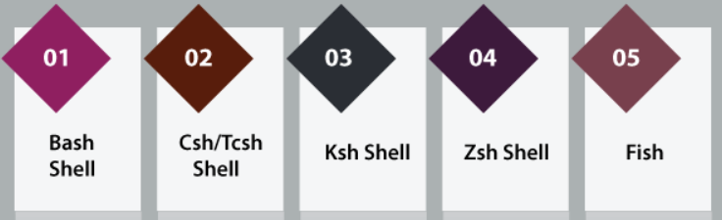
Red Hat Enterprise Linux 9 RH124

Slide 11
Red Hat Enterprise Linux 9 RH124
Describe Linux File System Hierarchy Concepts
The File-system Hierarchy
Specify Files by Name
Manage Files with Command-line Tools
Make Links Between Files
Match File Names with Shell Expansions

Slide 12

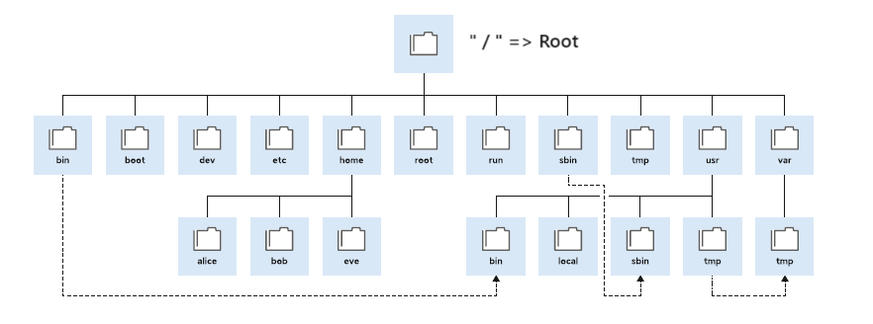
The File-system Hierarchy

Slide 13
Specify Files by Name
Absolute Paths and Relative Paths
An absolute path is a complete path to a file or directory from the root directory. The root directory is the top-level directory of the file system and is represented by a forward slash (/). Absolute paths always start with the root directory and provide the full path to the file or directory.
For example, the absolute path to the home directory of a user named “tom" would be "/home/tom".

Slide 14
Specify Files by Name
Absolute Paths and Relative Paths
On the other hand, a relative path is a path to a file or directory that is relative to the current directory. It specifies the location of the file or directory in relation to the current directory. Relative paths do not start with the root directory and are usually shorter than absolute paths.
For example, if you are currently in the home directory of “tom" and want to access a file named "example.txt" in a subdirectory called "documents", the relative path would be "documents/example.txt".

Slide 15
Command-line File Management
Create, copy, move, and remove files and directories

Slide 16
Manage Links Between Files
You can create multiple file names that point to the same file. These file names are called links.
You can create two types of links: a hard link, or a symbolic link (sometimes called a soft link). Each way has its advantages and disadvantages.
What is Soft Link And Hard Link In Linux?
A link in UNIX is a pointer to a file.
A symbolic or soft link is an actual link to the original file, whereas a hard link is a mirror copy of the original file. If you delete the original file, the soft link has no value, because it points to a non-existent file. But in the case of hard link, it is entirely opposite. If you delete the original file, the hard link can still has the data of the original file. Because hard link acts as a mirror copy of the original file.

Slide 17
Manage Links Between Files
In a nutshell, a soft link
can be created across different file systems,
allows you to link between directories,
has different inodes number and file permissions than original file,
permissions will not be updated.
A hard Link
can’t cross the file system boundaries,
can’t link directories,
has the same inodes number and permissions of original file,
permissions will be updated if we change the permissions of source file,

Slide 18
Match File Name with Shell Expansions
The Bash shell has multiple ways of expanding a command line, including
Pattern matching, home directory expansion, string expansion, and
variable substitution.

Slide 19
Red Hat Enterprise Linux 9 RH124
Getting Help in Red Hat Enterprise Linux
Introduction to the Linux Manual Pages
Navigate and Search man Pages
Search for man pages by Keyword
Lab: Get Help in Red Hat Enterprise Linux

Slide 20
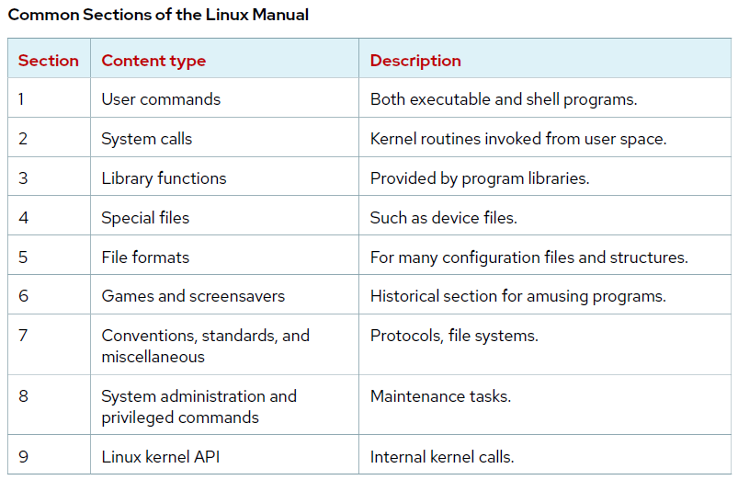
Getting Help in Red Hat Enterprise Linux

Slide 21
Red Hat Enterprise Linux 9 RH124
Create, View, and Edit Text Files
Standard Input, Standard Output, and Standard Error
Redirect Output to a File or Program
Examples for Output Redirection
Construct Pipelines
Pipelines Examples

Slide 22
Create, View, and Edit Text Files
Input Output Redirection in Linux
Every process in Linux is provided with three open files( usually called file descriptor). These files are the standard input, output and error files.
Standard Input, often abbreviated stdin, is the input data or a program. It is by default any text entered from the keyboard.
Standard Output, command line programs write to standard output, sometimes abbreviated stdout. Its default destination is generally the display screen, but it can be redirected
Standard Error, command line programs send error messages to the user via standard error, abbreviated stderr.

Slide 23
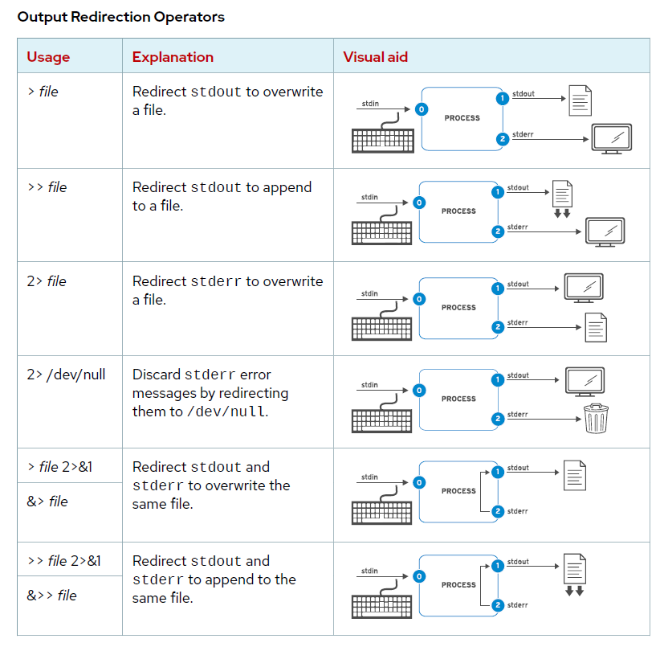

Slide 24
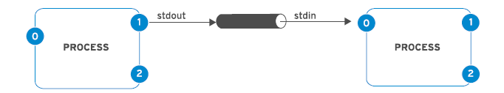
Create, View, and Edit Text Files
Construct Pipelines
A pipeline is a sequence of one or more commands that are separated by the vertical bar character(|). A pipeline connects the standard output of the first command to the standard input of the next command.
Examples:
[user@host ~]$ ls | wc -l
[user@host ~]$ ls -l /usr/bin | less

Slide 25
Create, View, and Edit Text Files
Edit Files with Vim
Vim is an improved version of the vi editor, which is distributed with Linux and UNIX systems.
Vim is highly configurable and efficient for practiced users, including split-screen editing, color formatting, and highlighting for editing text.
Vim Operating Modes
It has several modes of operation
Command Mode
Insert Mode
Extended Command Mode
Visual Mode

Slide 26
Create, View, and Edit Text Files
Change the Shell Environment
Set shell variables to run commands, and edit Bash startup scripts to set shell and environment variables to modify the behavior of the shell and programs that are run from the shell.
Shall Variable Usage
Assign Values to Variables
Retrieve Values with Variable Expansion
Configure Bash with Shell Variables
Configure Programs with Environment Variables
Set the Default Text Editor

Slide 27
Create, View, and Edit Text Files
Less command in Linux
The ‘less’ command works by reading the file one screen at a time, which makes it faster and more efficient for large files compared to commands like ‘cat’, which read the entire file into memory before displaying it.
It includes several additional features that make it a powerful tool for viewing and navigating files in Linux.
Let’s take a look at an example of how the ‘less’ command interacts with the Linux file system:
less /var/log/syslog
In this example, we’re using the ‘less’ command to view the system log file located in the /var/log directory.
The ‘less’ command reads the file one screen at a time, allowing you to navigate through it without loading the entire file into memory.

Slide 28
Red Hat Enterprise Linux 9 RH124
Change the Shell Environment
Shell Variable Usage
Assign Values to Variables
Retrieve Values with Variable Expansion
Configure Bash with Shell Variables
Configure Programs with Environment Variables
Set the Default Text Editor

Slide 29
Red Hat Enterprise Linux 9 RH124
Manage Local Users and Groups
What is a User & Group?
Primary Groups & Secondary Groups
Superuser
Configure sudo
Manage Local User Accounts
Manage Users Passwords

Slide 30
Manage Local Users and Groups
What is a User?
A user account is used to provide security boundaries between different people and programs that can run commands.
Since Linux is a multi-user operating system (in that it allows multiple users on different computers or terminals to access a single system), you will need to know how to perform effective user management: how to add, edit, suspend, or delete user accounts, along with granting them the necessary permissions to do their assigned tasks.
There are three main types of user account: the superuser, system users, and regular users.
The superuser account is for administration of the system. The name of the superuser is root and the account has UID 0. The superuser has full access to the system.
The system user accounts are used by processes that provide supporting services. These processes, or daemons, usually do not need to run as the superuser. Users do not interactively log in with a system user account.
Most users have regular user accounts for their day-to-day work. Like system users, regular users have limited access to the system.

Slide 31
Manage Local Users and Groups
What is a Group?
A group is a collection of users that need to share access to files and other system resources. Groups can be used to grant access to files to a set of users instead of just a single user.
Like users, groups have group names to make them easier to work with. Internally, the system distinguishes groups by the unique identification number assigned to them, the group ID or GID.
Primary Groups and Secondary Groups
Primary Group: This is the group applied to you when you log in; in most user cases it has the same name as your login name. The primary group is used by default when creating new files (or directories), modifying files, or executing commands.
Secondary Groups : Users may also have secondary groups. Membership in secondary` groups is determined by the /etc/group file. Users are granted access to files based on whether any of their groups have access. It doesn't matter if the group or groups that have access are primary or supplementary for the user.

Slide 32
Manage Local Users and Groups
The Superuser
Most operating systems have a superuser that has all power over the system. In Red Hat Enterprise Linux, it is the root user.
The root user has unlimited power to damage the system: remove files and directories, remove user accounts and so on.
Red Hat encourages system administrators to log in always as a normal user and escalate privileges to root only when needed.
Switch User Accounts
With the su command, users can switch to a different user account.
[user01@host ~]$ su - user02
Password: user02_password
[user02@host ~]$
[user01@host ~]$ su –
Password: root_password
[root@host ~]#

Slide 33
Red Hat Enterprise Linux 9 RH124
Control Access to Files
Linux File-system Permissions
View File and Directory Permissions and Ownership
Examples of Permissions Effects
Manage File System Permissions from the Command Line
Manage Default Permissions and File Access

Slide 34
Control Access to Files
Linux File-system Permissions
In Linux, file and directories access is controlled by permissions. These access permissions are granted to 3 user categories:
owner,
group, and
others.
Permissions in Linux are read, write and execute. Let's define each permission:
Read: The read permission for a file means the user can open and view the content. For a directory (folder) the user can list the contents of the directory.
Write: This allows the user to modify or delete files. For directories, it enables users to add or remove files and subdirectories.
Execute: This enables user to run executable files. For example for programs and shell scripts.

Slide 35
Control Access to Files
Linux File-system Permissions
Symbolic Notations:
The symbolic notations (relative mode) are represented by characters. The following represent the characters and its permissions:
r - read permission.
w - write permission.
x - execute permission.
- (hyphen) - when permission is not granted.
Numerical notations
Chmod numerical mode is also known as an absolute mode. This is represented by 3-digit octal numbers.
4 - read permission.
2 - write permission.
1 - execute permission.
This permission is set individually or sum of the numbers for the user category.

Slide 36
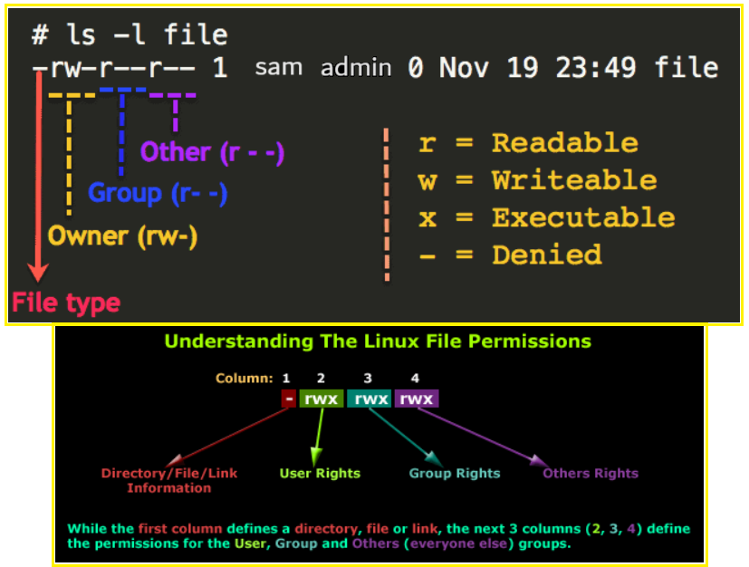
Control Access to Files
Linux File-system Permissions

Slide 37
Control Access to Files
Default File Permissions
On creation, a file is assigned initial permissions. Two things affect these initial permissions. The first is whether you are creating a regular file or a directory. The second is the current umask, which stands for user file-creation mask.
If you create a directory, then its initial octal permissions are 0755 (drwxr-xr-x). If you create a regular file, then its initial octal permissions are 0644 (-rw-r—r--).
The umask command without arguments displays the current value of the shell's umask:
[user@host ~]$ umask
0022
Making a directory/File:
When we make a new directory, the permissions will be calculated as i.e. 777 – 022 = 755
When we make a new file, the permissions will be calculated as – i.e. 666 – 022 = 644

Slide 38
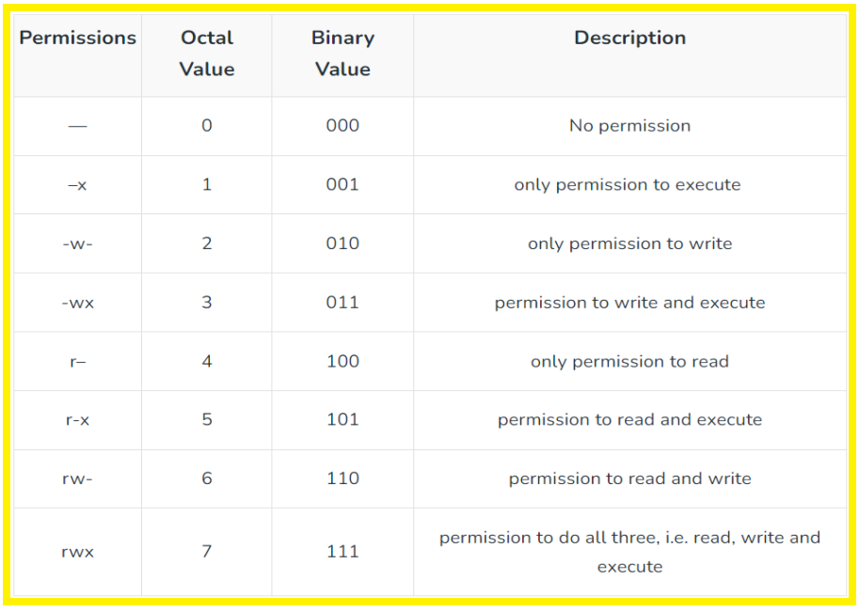
Control Access to Files
Default File Permissions

Slide 39
Red Hat Enterprise Linux 9 RH124
Monitor and Manage Linux Processes
Process States and Lifecycle
Definition of a Process
Describe Process States
Importance of Process States
Listing Processes

Slide 40
Monitor and Manage Linux Processes
Definition of a Process
A process is a running instance of a launched, executable program. From the moment that a
process is created, it consists of the following items:
* An address space of allocated memory.
* Security properties including ownership credentials and privileges.
* One or more execution threads of program code.
* A process state.
The environment of a process is a list of information that includes the following items:
* Local and global variables.
* A current scheduling context.
* Allocated system resources, such as file descriptors and network ports.

Slide 41
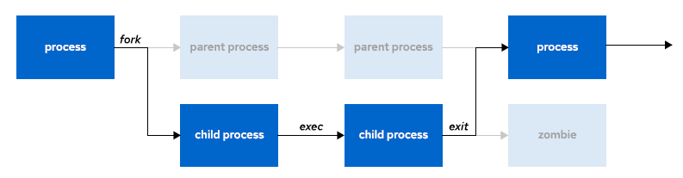
Monitor and Manage Linux Processes
Definition of a Process
An existing parent process duplicates its own address space, which is known as a process fork, to create a child process structure.
Every new process is assigned a unique process ID (PID) for tracking and security purposes. The PID and the parent's process ID (PPID) are elements of the new process environment.
Any process can create a child process.
All processes are descendants of the first system process, systemd, on a Red Hat system.

Slide 42
Monitor and Manage Linux Processes
Definition of a Process
Through the fork routine, a child process inherits security identities, previous and current file descriptors, port and resource privileges, environment variables, and program code. A child process can then execute its own program code.
Normally, a parent process sleeps while the child process runs, setting a wait request to be signaled when the child completes. After the child process exits, it closes or discards its resources and environment, and leaves a zombie resource, which is an entry in the process table.

Slide 43
Red Hat Enterprise Linux 9 RH124
Monitor and Manage Linux Processes
Practice Lab Session

Slide 44
Monitor and Manage Linux Processes
Control Jobs
When you start a process (run a command), there are two ways you can run it −
Foreground Processes
Background Processes

Slide 45
Monitor and Manage Linux Processes
Control Jobs
Foreground Processes
By default, every process that you start runs in the foreground. It gets its input from the keyboard and sends its output to the screen.
You can see this happen with the ls command. If you wish to list all the files in your current directory, you can use the following command:

Slide 46
Monitor and Manage Linux Processes
Control Jobs
Foreground Processes
The process runs in the foreground, the output is directed to my screen, and if the ls command wants any input (which it does not), it waits for it from the keyboard.
While a program is running in the foreground and is time-consuming, no other commands can be run (start any other processes) because the prompt would not be available until the program finishes processing and comes out.

Slide 47
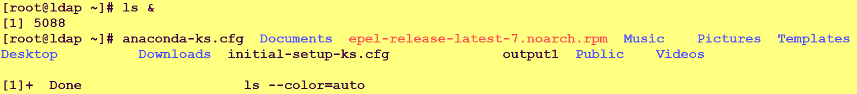
Monitor and Manage Linux Processes
Control Jobs
Background Processes
A background process runs without being connected to your keyboard.
The advantage of running a process in the background is that you can run other commands; you do not have to wait until it completes to start another!
The simplest way to start a background process is to add an ampersand (&) at the end of the command.

Slide 48
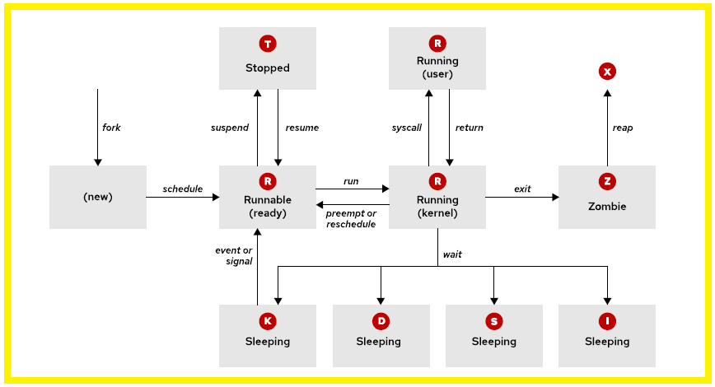
Monitor and Manage Linux Processes
Describe Process State

Slide 49
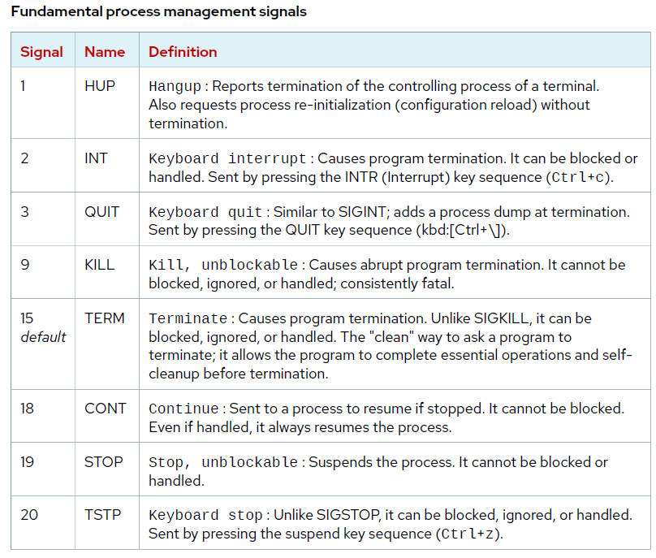
Monitor and Manage Linux Processes
Process Control with Signals
A signal is a software interrupt that is delivered to a process.
Signals report events to an executing program. Events that generate a signal can be an error, an external event (an I/O request or an expired timer), or by the explicit use of a signal-sending command or keyboard sequence.

Slide 50
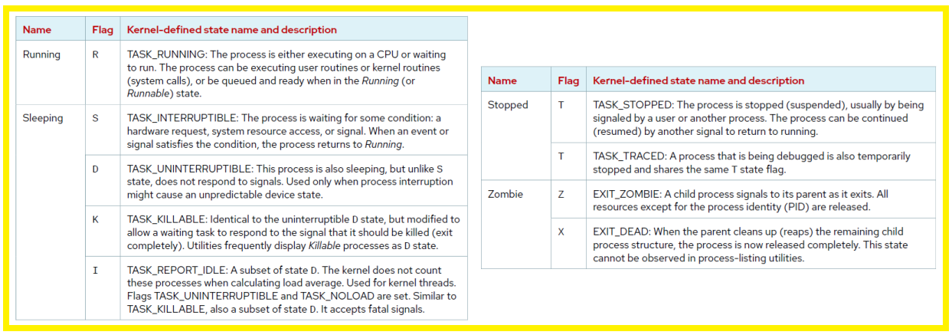
Monitor and Manage Linux Processes
Describe Process State

Slide 51
Red Hat Enterprise Linux 9 RH124
Controlling Services and Daemons
Practice Lab Session

Slide 52
Red Hat Enterprise Linux 9 RH124
Controlling Services and Daemons
RHEL9 new features

Slide 53
What’s New in RHEL 9
Understanding Red Hat Enterprise Linux 9
Exciting news for fans of RED HAT! Red Hat Enterprise Linux 9 (RHEL 9) is now accessible to customers. You can download RHEL 9 for free by subscribing to the Red Hat Developer program.
It was released on the market on May 17, 2022. The new version comes with enhanced features, improved security, and updated packages to enhance the developer's experience. Red Hat Enterprise Linux 9 offers extended RHEL 8 module packaging features.
Red Hat Enterprise Linux 9 is powered by the Linux 5.14 kernel. It includes new and improved features such as enhanced web console performance metrics, Smart Card Authentication via the web console, new security profiles, Integrity Measurement Architecture (IMA) digital hashes and signatures, SSSD login, OpenSSL 3 integration, and the disabling of SSH root password login to enhance security.

Slide 54
What’s New in RHEL 9
RHEL 9 Release with new features
Improved performance metrics for web console
Kernel live patching
Streamlined image building
Enhanced security
  The web console now supports smart card authentication.
  There are new SELinux security profiles available.
  SSSD Logging has been enhanced with more details and improved search capabilities.
  OpenSSL 3 is now integrated.
  The Integrity Measurement Architecture enables dynamic verification of the OS integrity.
  By default, the SSH root password is disabled.
Enhanced container development
Application updates

Slide 55
What’s New in RHEL 9
RHEL 9 Release with new features
RHEL 9 supports newer versions of programming languages:
  Python 3.9
  Node.js 16
  Ruby 3.0.3
  Perl 5.32
  PHP 8.0
It comes with preinstalled Version Control System
  Git 2.31
  Subversion 1.14
RHEL 9 is available with caching server
  Squid 5.2
  Varnish cache 6.6

Slide 56
What’s New in RHEL 9
RHEL 9 Release with new features
RHEL 9 comes with the following database support.
  MySQL 8.0
  MariaDB 10.5
  PostgreSQL 13
  Redis 6.2
RHEL 9 release with the following compilers and development tools
  GCC 11.2.1
  glibc 2.34
  binutils 2.35.2
Network-Scripts deprecated.
VDO (Virtual Data Optimizer) is now LVM.

Slide 57
Customize OpenSSH Service Configuration
Configure the OpenSSH Server
The sshd daemon provides the OpenSSH service. You can configure the service by editing the /etc/ssh/sshd_config file.
The default configuration of the OpenSSH server works well for many use cases. However, you might want to make some changes to strengthen the security of your system.
You might want to prohibit direct remote login to the root account, and you might want to prohibit password-based authentication (in favor of SSH private key authentication).

Slide 58
Customize OpenSSH Service Configuration
Prohibit the Superuser from Loggin In
It is a good practice to prohibit direct login to the root user account from remote systems. Some of the risks of allowing direct logins as the root user include the following cases:
The root user name is present on every Linux system as a default, which means that a potential attacker only needs to guess the password instead of both a valid user name and password combination. This simplifies the task for an attacker.
The root user has unlimited privileges, so if it is compromised, it can cause significant damage to the system.
From an auditing standpoint, it can be challenging to trace the activities of an authorized user who logs in as the root user and makes modifications. However, if users are required to initially log in as a regular user and then switch to the root account, you can refer to a log event to establish accountability.
The OpenSSH server utilizes the "PermitRootLogin" configuration setting in the "/etc/ssh/sshd_config" file to determine whether users are allowed or denied access to log in as root. The current setting is "PermitRootLogin yes."

Slide 59
Customize OpenSSH Service Configuration
Prohibit Password-based Authentication for SSH
Enabling only private key-based logins for the remote command line offers several advantages:
The OpenSSH server uses the PasswordAuthentication parameter in the /etc/ssh/sshd_config file to control whether users can use password-based authentication to log in to the system.
PasswordAuthentication yes

Slide 60
Red Hat Enterprise Linux 9 RH124
Analyze and Store Logs
System Logging
Log Events to the System
Log File Rotation
Analyze a Syslog Entry
Monitor Log Events
Find Events on the System Journal
System Journal Storage
Maintain Accurate Time

Slide 61
Analyze and Store Logs
System Logging
The operating system kernel and other processes record a log of events that happen when the system is running. These logs are used to audit the system and to troubleshoot problems. You can use text utilities such as the less and tail commands to inspect these logs.
In Red Hat Linux distributions, including Red Hat Enterprise Linux (RHEL), system logging is typically handled by the systemd-journald and rsyslog services. These services work together to collect, store, and manage log messages.
The systemd-journald service is a crucial component of the operating system's event logging system. It gathers event messages from various sources, including:
- The system kernel
- Output generated during the early stages of the boot process
- Standard output and standard error from daemons
- Syslog events
By default, this journal is stored on a file system that does not persist across reboots.

Slide 62
Analyze and Store Logs
System Logging
The rsyslog service reads syslog messages that the systemd-journald service receives from the journal as they arrive. The rsyslog service then processes the syslog events, and records them to its log files or forwards them to other services according to its own configuration.
The rsyslog service sorts and writes syslog messages to the log files that do persist across reboots in the /var/log directory. The service also sorts the log messages to specific log files according to the type of program that sent each message and the priority of each syslog message.

Slide 63
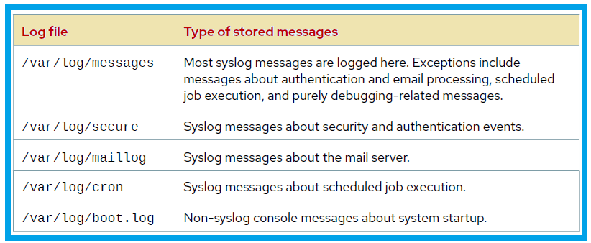
Analyze and Store Logs
Analyze and Store Logs

Slide 64
Analyze and Store Logs
Log Events to the System
Many programs use the syslog protocol to log events to the system. Each log message is categorized by facility (which subsystem produces the message) and priority (the message's severity).
Syslog server operates any log message using the following scheme:
  Type (facility).Priority (severity) Destination(where to send the log)

Slide 65
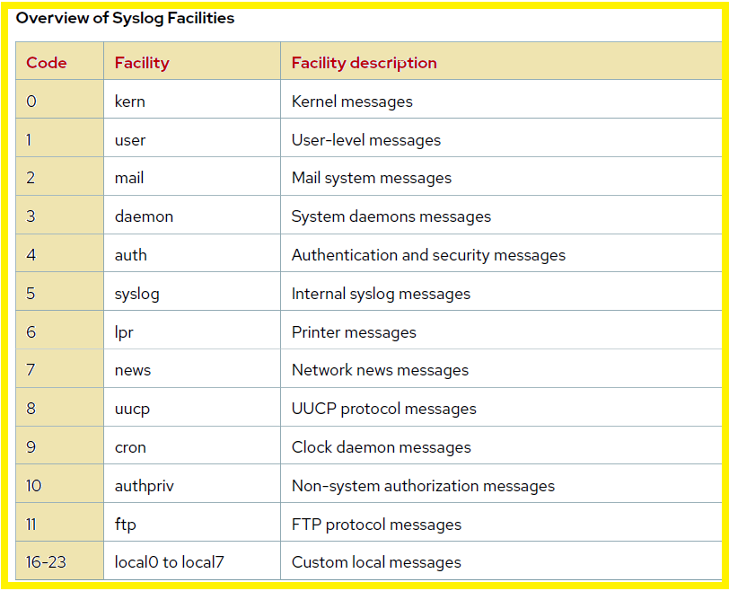
Analyze and Store Logs
  Type (facility).Priority (severity) Destination(where to send the log)

Slide 66
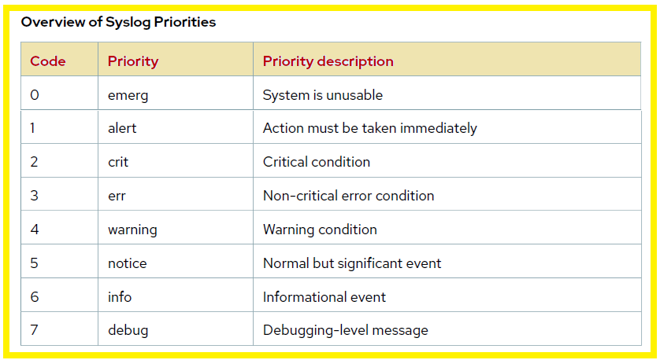
Analyze and Store Logs
  Type (facility).Priority (severity) Destination(where to send the log)

Slide 67
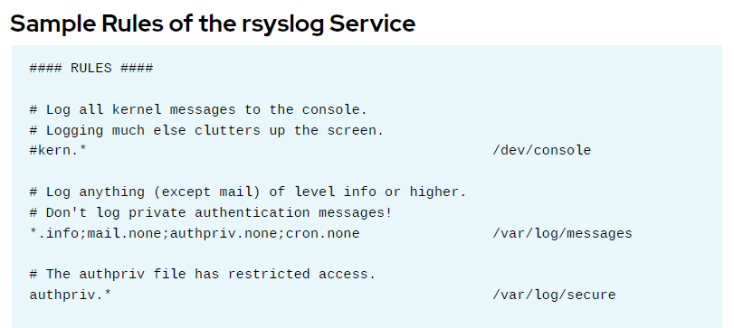
Analyze and Store Logs
Log Events to the System
For example, the following line in the /etc/rsyslog.d file would record messages that are sent to the authpriv facility at any priority to the /var/log/secure file:
authpriv.* /var/log/secure

Slide 68
Red Hat Enterprise Linux 9 RH124
Archive and Transfer Files
Managed Compressed tar Archives
Common Options of the tar Utility
Create an Archive
List and Extract Archive Contents
Create a Compressed Archive
Extract Compressed Archive Contents
Transfer Files Between System Securely
Synchronize Files Between Systems Securely

Slide 69
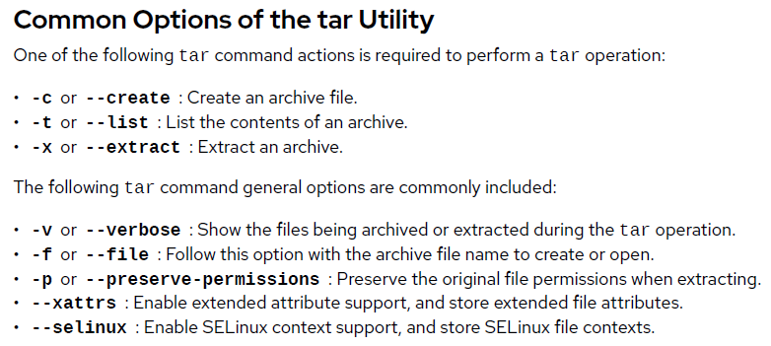
Archive and Transfer Files
Create Archives from the Command Line
An archive is a single regular file or device file that contains multiple files. The device file could be a tape drive, flash drive, or other removable media.
Archive files are used to create manageable personal backups, or to simplify the task of transferring a set of files across a network when other methods, such as rsync, are unavailable or might be more complex. Archive files can be created with or without using compression to make the archive file smaller.
On Linux, the tar utility is the common command to create, manage, and extract archives. Use the tar command to gather multiple files into a single archive file.

Slide 70
Archive and Transfer Files
Create a Compressed Archive
The tar command supports these compression methods, and others:
  gzip compression is the legacy, fastest method, and is widely available across platforms.
  bzip2 compression creates smaller archives but is less widely available than gzip.
  xz compression is newer, and offers the best compression ratio of the available methods.
  compress is a legacy LZ algorithm variation, and is widely available across platforms.

Slide 71
Red Hat Enterprise Linux 9 RH124
Find command

Slide 72
Find Command in Linux
The Linux Find Command is one of the most important and much used command in Linux systems. Find command used to search and locate list of files and directories based on conditions you specify for files that match the arguments.
Find command can be used in variety of conditions like you can find files by permissions, users, groups, file type, date, size and other possible criteria.
The find command is available on most Linux distros by default so you do not have to install any package. The find command is an essential one to learn, if you want to get super productive with the command line on Linux.
The basic syntax of the find command looks like this:
find [path] [options] [expression]

Slide 73
Red Hat Enterprise Linux 9
grep command

Slide 74
Grep Command in Linux
Grep is a Linux command-line tool that enables users to search files for a specific text pattern. When grep identifies a match, it displays the lines containing that pattern on the terminal.
By default, the grep command outputs entire lines that contain the match.
grep stands for "global regular expression print".
Syntax of grep command:
#grep '[search_pattern]' [file_name]
The grep command consists of three basic parts:
* The grep command itself.
* The pattern you are searching for.
* The file name that grep searches through.
For example, to search for the term "cloud computing" in the file named example_file2.txt, enter:
#grep 'cloud computing' example_file2.txt

Slide 75

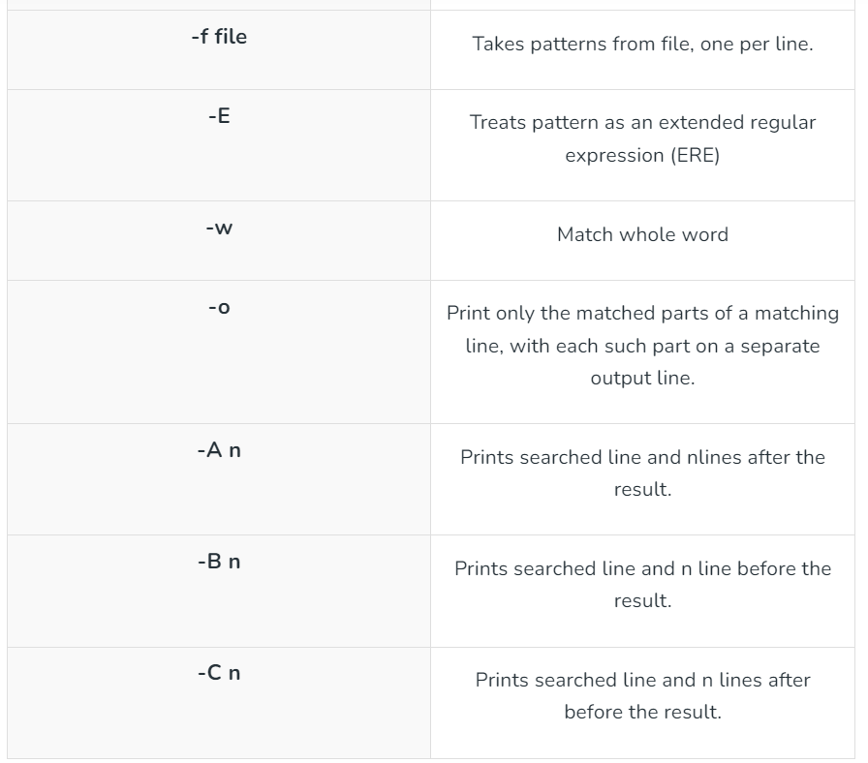
Grep Command in Linux

Slide 76
Red Hat Enterprise Linux 9
Sort command

Slide 77
Sort Command in Linux
The sort command is used in Linux to print the output of a file in given order.
This command processes your data (the content of a file or the output of any command) and reorders it in a specified manner, making it easier for us to read the data efficiently.
It is very useful when dealing with large amounts of information that need to be organized alphabetically or in ascending or descending numerical order.
In alphabetical sorting, the command checks the first letter of each line and moves the lines upward or downward to arrange each line in alphabetical order.
Syntax of sort command:
#sort ‘[option]' [file_name]

Slide 78
Red Hat Enterprise Linux 9
df command

Slide 79
df Command in Linux
The df command display information about file system disk space usage on the mounted file system.
Disk free also known as ‘df’, which is a powerful utility that provides valuable information on disk space utilization.
This command retrieves the information from ‘/proc/mounts’ or ‘/etc/mtab’.
The df command can be run by any user.
Syntax of df command:
#df [options] [filesystems]
* Options: These are optional flags that modify the output of the command.
* filesystems: You can specify specific filesystems (mount points) to check their usage instead of getting information for all mounted drives.
Note: If no file name is given, it displays the space available on all currently mounted file systems.

Slide 80
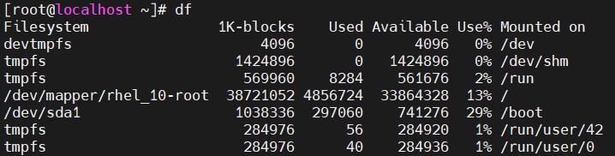
df Command in Linux
Example:
This will display information about all the mounted file systems which will include total size, used space, usage percentage, and the mount point as shown below:
* Filesystem: The name of the mounted storage device.
* Size: The total size of the filesystem in bytes.
* Used: The amount of space currently occupied by data in bytes.
* Avail: The amount of free space available in bytes.
* Use%: The percentage of the filesystem used.
* Mounted on: The directory where the filesystem is mounted (e.g., /, /home).

Slide 81
Red Hat Enterprise Linux 9
du command

Slide 82
du Command in Linux
du command display a list of all the files/directories along with their respective sizes. By default, size given is in kilobytes.
du stands for Disk Usage.
Syntax of du command:
#du [options] [directory/file]
Here,
[options] = various flags that modify the behavior of the command
[directory/file] = The target directory or file for which disk usage information is desired. If no directory or file is specified, du will default to the current directory.

Slide 83
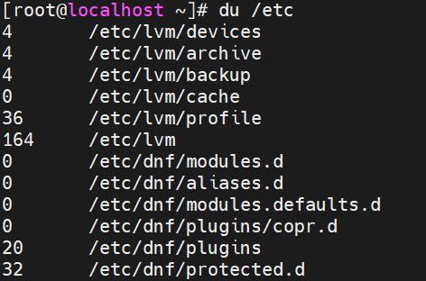
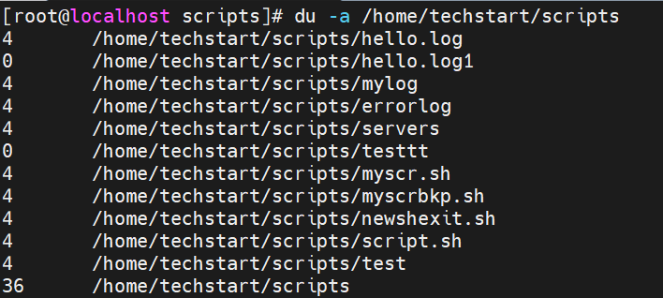
df Command in Linux
Example:

Slide 84
Skill two: Introduction to digital logic
Formula
Logic
Sequence
Boolean algebra and its significance in computer generating
Logic gates: and, or, not, and their truth tables
Combinational and sequential circuits

Slide 85
Skill two: Introduction to digital logic
Formula
Logic
Sequence
Boolean algebra and its significance in computer generating
Logic gates: and, or, not, and their truth tables
Combinational and sequential circuits

Slide 86



Skill two: Introduction to digital logic (2)
Formula
Logic
Sequence
Boolean algebra and its significance in computer generating
Logic gates: and, or, not, and their truth tables
Combinational and sequential circuits

Slide 87

Skill three: Computer architecture
An overview of the fundamental principles that govern the design and structure of computer systems, including topics like instruction set architecture, data representation, and system organization.
Explore the internal structure and organization of a central processing unit, including registers, arithmetic logic units, control units, and pipelines.
Discuss the concept of memory hierarchy and its impact on computer performance, covering various levels of memory such as cache, main memory, and secondary storage devices.

Slide 88

Lesson one summary
What we’ve learned so far
Skill one
Familiarize students with the basics of computer engineering and the key components of a computer system.
Skill two
Introduce students to digital logic, Boolean algebra, and the design of logic circuits.
Skill three
Explore the internal organization of computers, including CPU design and memory systems.

Slide 89
Course progress
o1.
Intro to Computer Engineering
o2.
Digital Logic and Boolean Algebra
o3.
Computer Architecture
o4.
Programming Fundamentals
o5.
Data Structure and Algorithms

Slide 90
Course progress (2)
o1.
Intro to Computer Engineering
o2.
Digital Logic and Boolean Algebra
o3.
Computer Architecture
o4.
Programming Fundamentals
o5.
Data Structure and Algorithms

Slide 91

Thank you
Office hours:
M-Th 3:00pm-4:30pm room C402
Please send all questions to:
gehad@example.com

